Slide 1
Model View Control (MVC)

Slide 2
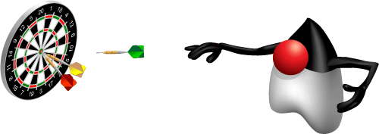
Agenda
Understanding the benefits of MVC
Using RequestDispatcher to implement MVC
Forwarding request from servlets to JSP
Handling relative URL

Slide 3
Model-View-Controller
Definition
An approach where you break the response into three pieces
The controller: the part that handles the request, decides what logic to invoke, and decides what JSP page should apply
The model: the classes that represent the data being displayed The view: the JSP pages that represent the output that the client sees
Examples
MVC using RequestDispatcher
Struts (not on exam)
JSF (not on exam)

Slide 4
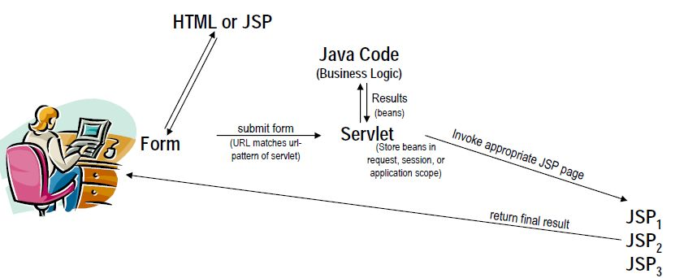
What is MVC

Slide 5
MVC Misconceptions
An elaborate framework is necessary
Frameworks are sometimes useful
Struts
JavaServer Faces (JSF)
Implementing MVC with the builtin RequestDispatcher
works very well for most simple and moderately complex
applications
MVC totally changes your overall system design
You can use MVC for individual requests
Think of it as the MVC approach, not the MVC architecture

Slide 6
Java Beans revisted
Java classes that follow certain conventions
Must have a zero-argument (empty) constructor
You can satisfy this requirement either by explicitly defining such a constructor or by omitting all constructors
Should have no public instance variables (fields)
I hope you already follow this practice and use accessor methods instead of allowing direct access to fields
Persistent values should be accessed through methods
called getXxx and setXxx
If class has method getTitle that returns a String, class is said to have a String property named title
Boolean properties can use isXxx instead of getXxx

Slide 7
Implementing MVC with RequestDispatcher
Define beans to represent the data
Use a servlet to handle requests
Servlet reads request parameters, checks for missing and malformed data.
Populate the beans
The servlet invokes business logic (application-specific code) or data-access code to obtain the results. Results are placed in the beans that were defined in step 1.
Store the bean in the request, session, or servlet context
The servlet calls setAttribute on the request, session, or servlet context objects to store a reference to the beans that represent the results of the request.

Slide 8
Implementing MVC with RequestDispatcher
Forward the request to a JSP page.
The servlet determines which JSP page is appropriate to the situation and uses the forward method of RequestDispatcher to transfer control to that page.
Extract the data from the beans.
The JSP page accesses beans with jsp:useBean and a scope matching the location of step 4. The page then uses jsp:getProperty to output the bean properties.
The JSP page does not create or modify the bean; it merely extracts and displays data that the servlet created.

Slide 9
Request Forwarding example
public void doGet(HttpServletRequest request, HttpServletResponse response) throws ServletException, IOException {
String operation = request.getParameter("operation");
if (operation == null) {
operation = "unknown";
}
String address;
if (operation.equals("order")) {
address = "/WEB-INF/Order.jsp";
} else if (operation.equals("cancel")) {
address = "/WEB-INF/Cancel.jsp";
} else {
address = "/WEB-INF/UnknownOperation.jsp";
}
RequestDispatcher dispatcher = request.getRequestDispatcher(address);
dispatcher.forward(request, response);
}

Slide 10
Scope Alternatives
request
<jsp:useBean id="..." type="..." scope="request" />
Session
<jsp:useBean id="..." type="..." scope="session" />
application
<jsp:useBean id="..." type="..." scope="application" />\
Page
<jsp:useBean id="..." type="..." scope="page" />
or just
<jsp:useBean id="..." type="..." />
This scope is not used in MVC (Model 2) architecture

Slide 11
Using jsp:useBean in MVC
The JSP page should not creat the objects
The servlet, not the JSP page, should create all the data objects. So, to guarantee that the JSP page will not create objects, you should use
<jsp:useBean ... type="package.Class" />
instead of
<jsp:useBean ... class="package.Class" />
The JSP page should not modify the objects
So, you should use jsp:getProperty but not jsp:setProperty.

Slide 12
Session-Based Data Sharing
Use response.sendRedirect instead of RequestDispatcher.forward
Distinctions: with sendRedirect:
User sees JSP URL (user sees only servlet URL with RequestDispatcher.forward)
Two round trips to client (only one with forward)
Advantage of sendRedirect
User can visit JSP page separately
User can bookmark JSP page
Disadvantage of sendRedirect
Since user can visit JSP page without going through servlet first, JSP data might not be available
So, JSP page needs code to detect this situation

Slide 13
Request based Data Sharing
Servlet
ValueObject value = new ValueObject(...);
request.setAttribute("key", value);
RequestDispatcher dispatcher =request.getRequestDispatcher
("/WEB-INF/SomePage.jsp");
dispatcher.forward(request, response);

Slide 14
Request based Data Sharing
JSP 1.2
<jsp:useBean id="key" type="somePackage.ValueObject"
scope="request" />
<jsp:getProperty name="key" property="someProperty" />
JSP 2.0
${key.someProperty}

Slide 15
Summary
MVC a established Design Pattern
Seperation of Concerns
View can be independent of Navigation rules and Business logic
Business logic can be implemented using JavaBean of EJB
RequestDispatcher is used to ensure control resides with Servlet

